Slide 1


Lunch & Learn
.
November 4th 2022

Slide 2
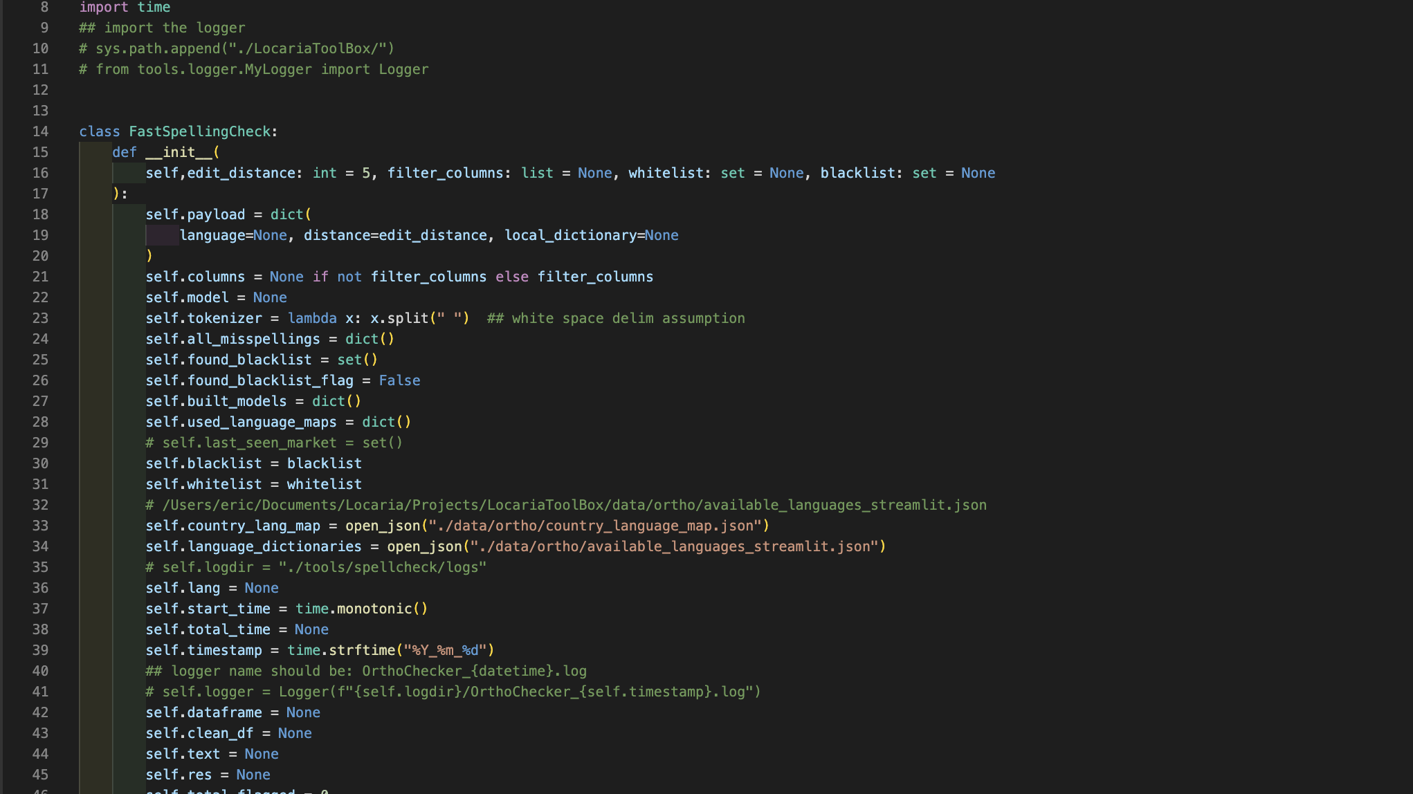


Fast, Simple & Easy Web-Apps
Using python and Streamlit

Slide 3

Why bother?
What about Front End? Web Dev?
Ever wanted to share / build an interactive:
Exploratory Data Analysis (EDA)?
Experiment?
Research Project?
Quick prototype?
But didn’t feel like learning:
Javascript or Web Dev framework (React, Node, Angular…)
CSS styling
PHP

Slide 4


Slide 5





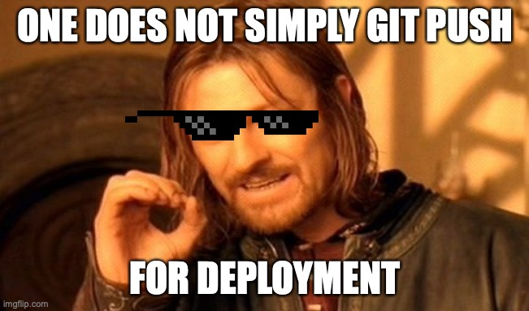
What’s cool about it?
Code:
Pure python
Components:
Pre-built components by the community (for the community)
Reactive
Design can be extended with CSS and JS
Device agnostic (Responsive design: mobile, desktop, etc.)
Hosting:
Free (1 GB)
Public and Private Apps
1 Live Private App per user
Simply “git push –u origin main” for deployment

Slide 6
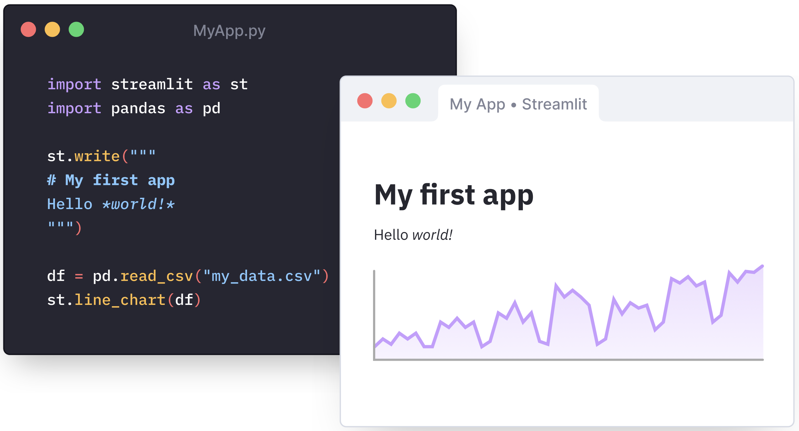
How simple is it?

Slide 7
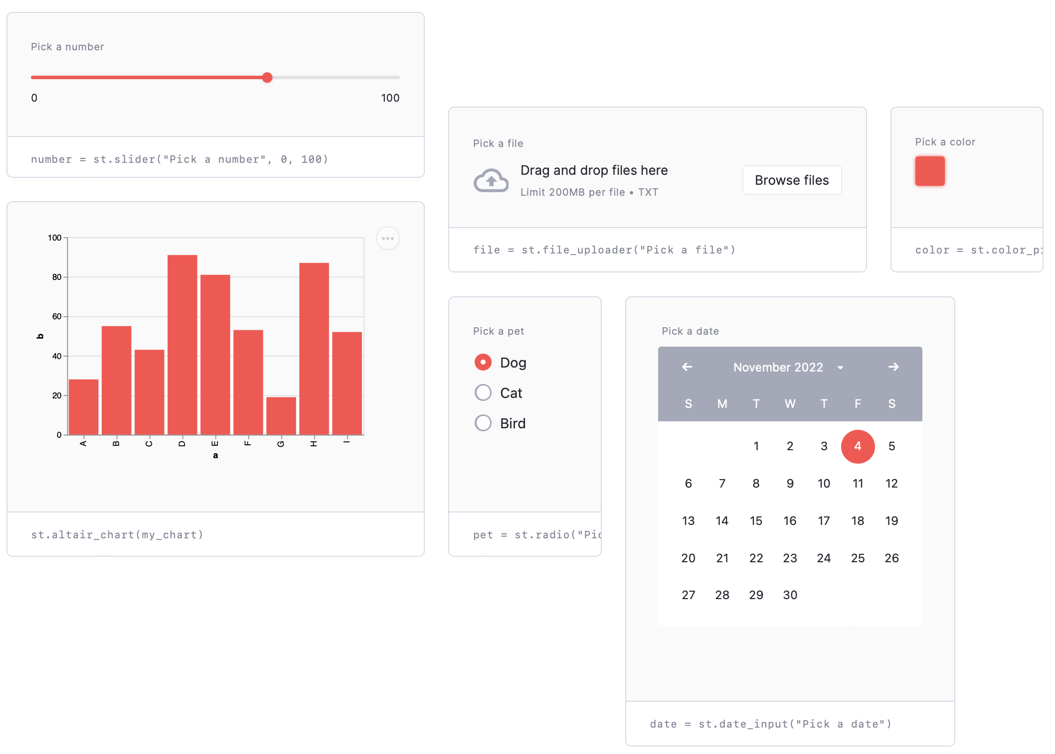
What components are available?

Slide 8
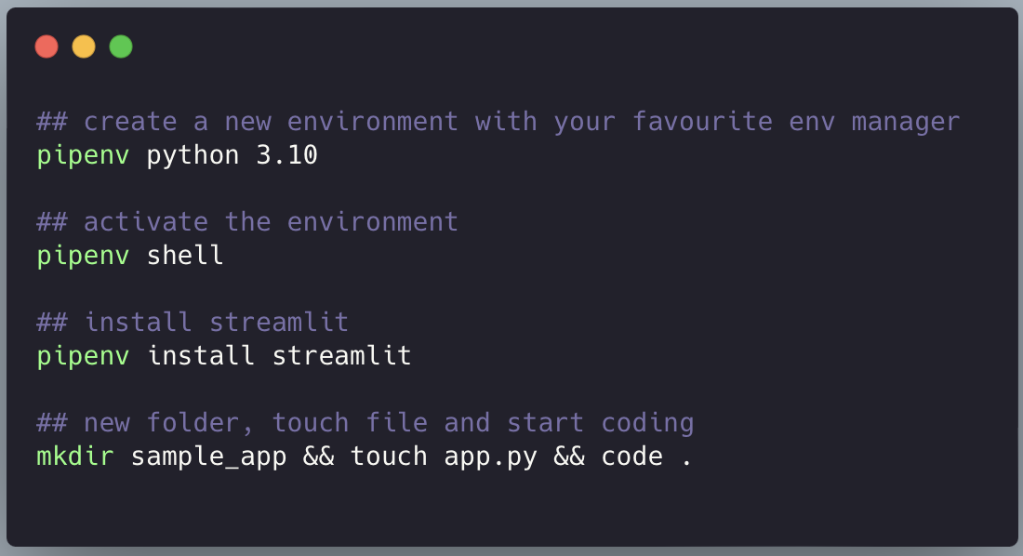
Installation

Slide 9

Demo
Notes:
Demo link:
https://eric-wk-lunchnlearn-app-20vkpm.streamlit.app

Slide 10
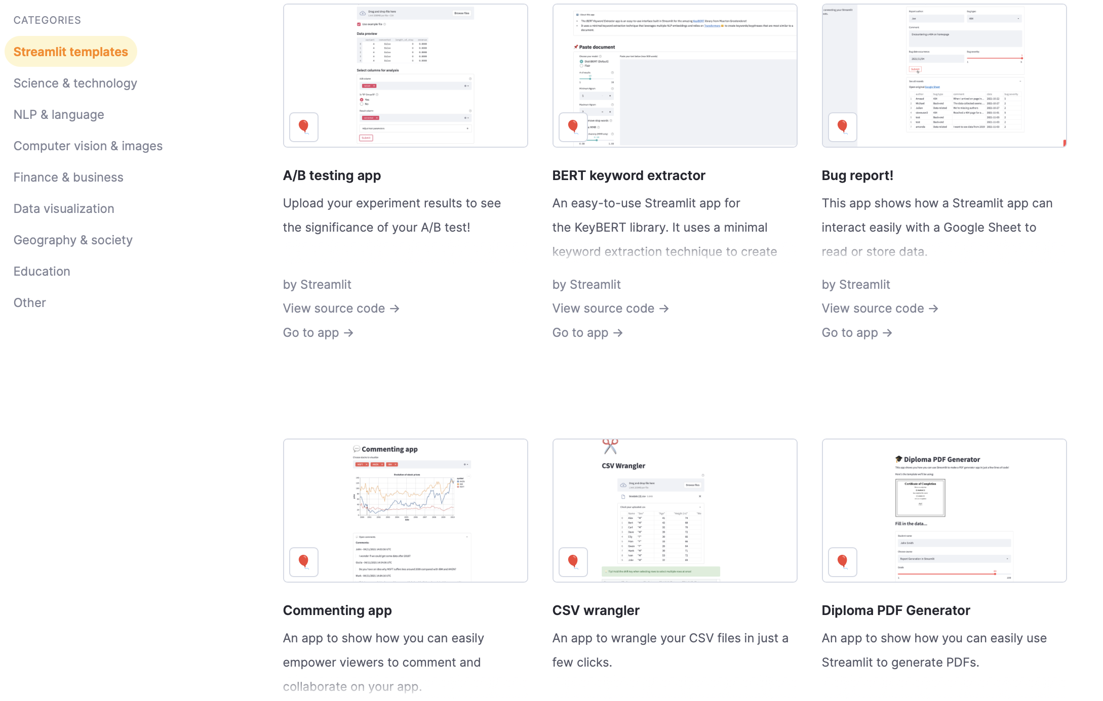
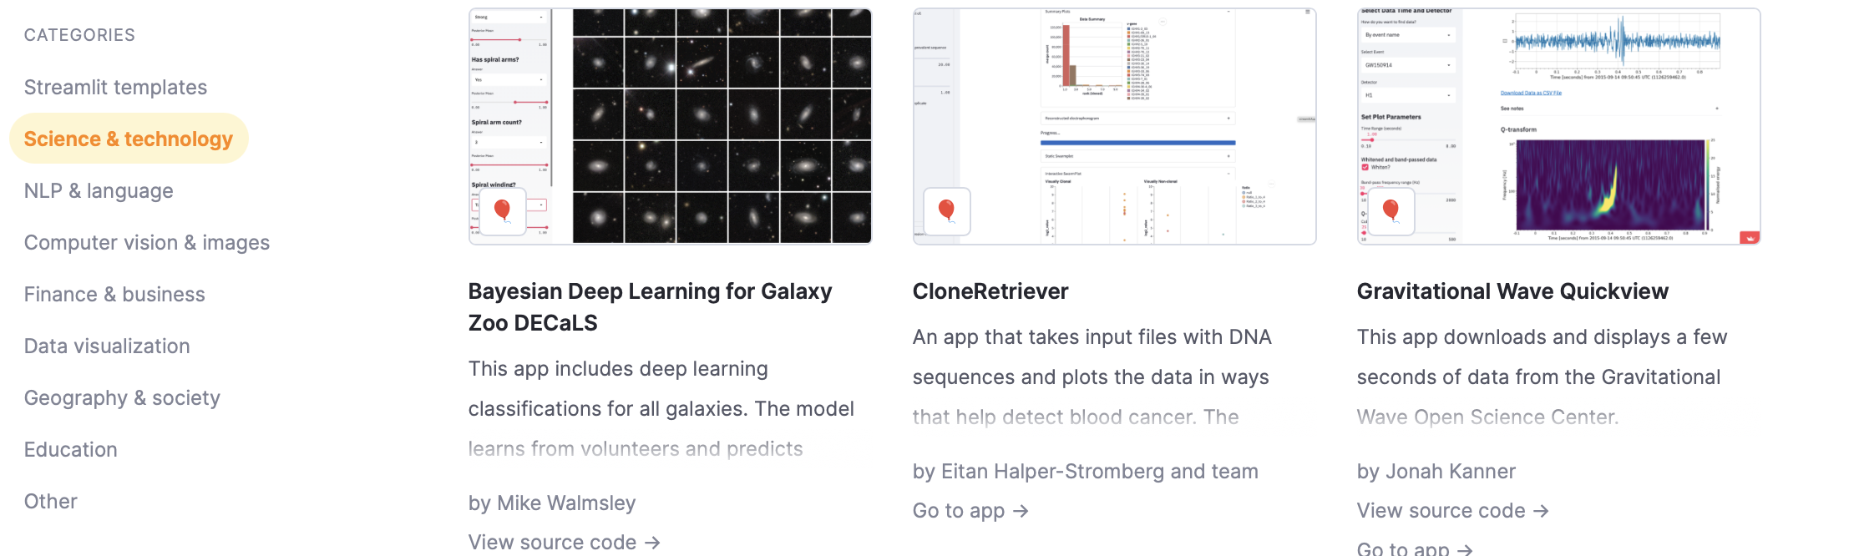
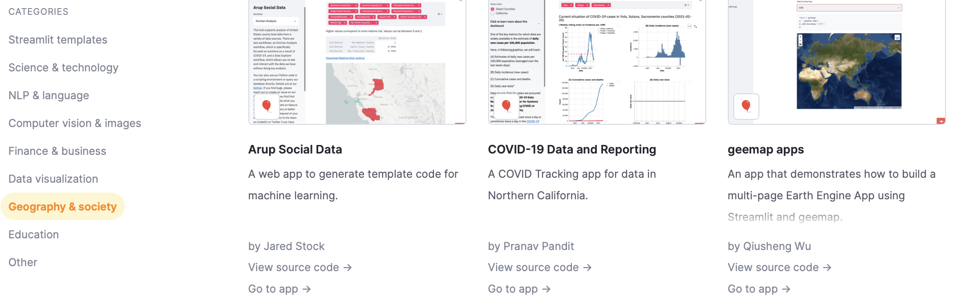
Sources:
Demo Link : https://eric-wk-lunchnlearn-app-20vkpm.streamlit.app
Repo Link: https://github.com/Eric-WK/LunchNLearn
Streamlit website: https://streamlit.io
Available components: https://streamlit.io/components
Gallery (pre-built Apps): https://streamlit.io/gallery

